Slide 1
GAS LEAKAGE DETECTOR
Developed By:
Harleen Kaur Mander (1610991342)
Drishti Setia (1610991290)
Harshita Aggarwal (1610991357)
Harsimran Gill (1610991359)

Slide 2
INTRODUCTION
LPG is essential in our daily life .
Now a days the use of LPG is extended to so many applications.
Though it is useful, if it leaks tends to explosion.
So the leakage of this gas has to be detected to avoid unnecessary explosions.
This circuit can detect leakages in our homes, car or in a service station, storage tank environment.

Slide 3
OBJECTIVES OF THE PROJECT
Detect gas leakage (like LPG leak, butane leak, methane leak) or any such petroleum based gaseous substance that can be detected using sensor.
Produce a sound alarm upon gas leak and stop the alarm once gas leak is under control (gas presence in atmosphere is under normal range).
Turn on the exhaust fan and pull the gas out from the room.
Display status in an LCD using a 16x2 LCD module.

Slide 4
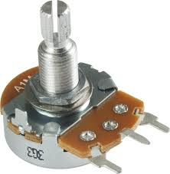
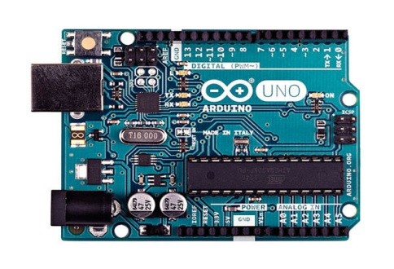
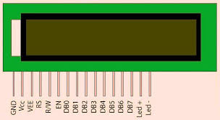

MAIN COMPONENTS
ARDUINO UNO 16x2 LCD SENSOR POTENTIOMETER

Slide 5

PLANNING OF COMPONENTS
MQ3-to sense LPG(use Digital Out to detect level status)
Arduino
- To read MQ3 output and detect gas leak(through level comparison).
- To activate outputs upon gas leak-sound alarm and exhaust.
- To send Status message commands to LCD Module.
- To Turn ON & OFF sound alarm.
LCD module- To display status message.
Buzzer- to produce alarm sound.

Slide 6
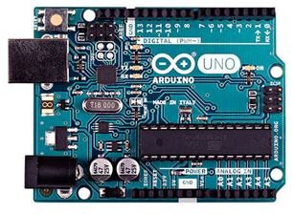
ARDUINO
Arduino Uno- an electronic prototyping platform/ board based
on Atmega AVR Microcontroller-Atmega328P(8 bits,16Mhz)
Operates on +5 Volts
14 Digital input pins(out of which 6 are PWM)
6 Analog input pins
32 KB flash memory & 1KB EEPROM
Serial communication enabled

Slide 7
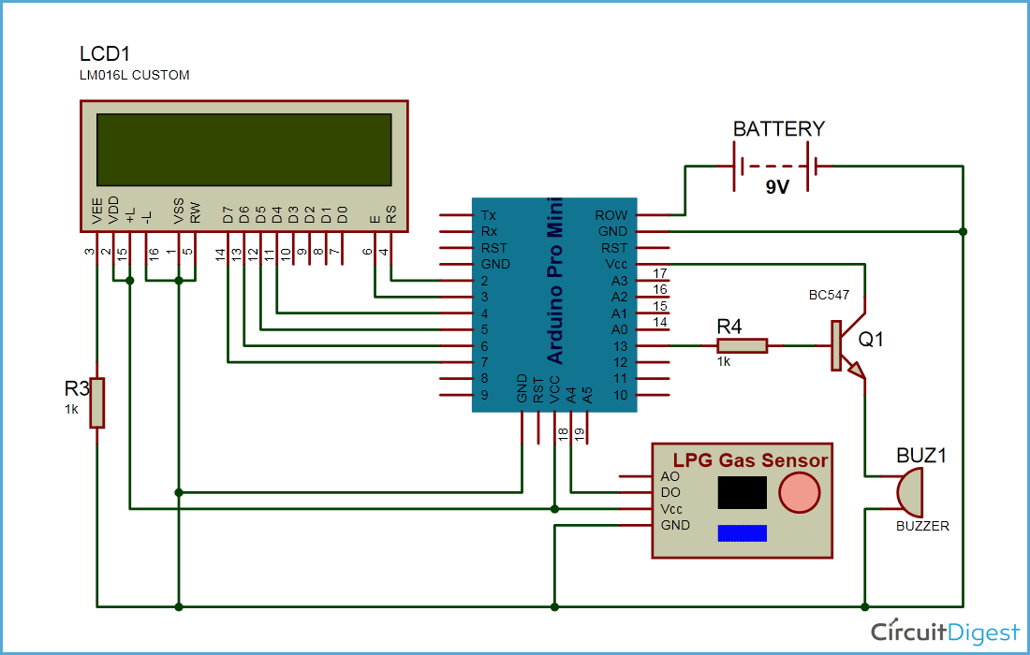
CIRCUIT DIAGRAM

Slide 8
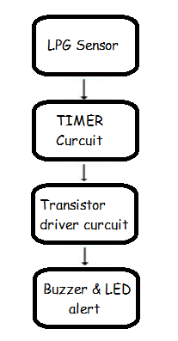
BLOCK DIAGRAM

Slide 9
APPLICATIONS
HOME SECURITY - Can be used in homes to prevent accidents due to gas leak
INDUSTRIAL SECURITY - Can be used in sensitive areas to prevent any accidents.
ENHANCEMENT – Can be enhanced to measure specific gas levels to use in industrial applications.
AUTOMATION – Can be enhanced to automate electrical cut off process to prevent short circuit.

Slide 10
SCOPE
Due to the increased cost of the fuel, most of them prefer in hiring the gas cars instead of petrol/diesel vehicles. Using gas in the cars is highly a risk issue, which will cause major accidents due to the leakage of LPG Gas. In order to overcome this problem LPG gas leakage is protected by using a protection system. We designed and developed such type of system, in order to prevent the number of accidents in gas cars; this project is not only for cars it can be used for homes too.

Slide 11
ADVANTAGES & DISADVANTAGES
Advantages
Disadvantages
Detects products of combustion.
Sensitive enough to detect level of gases.
Detects gases prior to reaching lethal levels.
Produced between the occurrences of detectable level and detectable heat levels.
Can be prone false alarms.
Must be mounted at a low level.
Can be poisoned.
Cannot be considered as a universal replacement and thermal detectors.
High cost

Slide 12
CONCLUSION
Smoke detector is one of the easiest and has low cost.
Most of industries use it because it work fatly to
protect and is most effective.
In future the use of gas and smoke detection will
increase.
In future we can include Bluetooth module.
Finally we completed this project using MQ3 sensor.

Slide 13
REVIEW

